Slide 1

Master System Design
Complete Tutorial

Slide 2

What Is System Design ?
Why we need System Design ?
Components should know for System Design
- DNS resolver and registerer
- vertical Scaling
- Horizontal Scaling
-Load Balancers
- CDN
-Caches
-Network Protocol
- APIs
- Latency Vrs ThroughPut
- Database's
-ACID properties of DBs
- Optimizing Technique in DB
- CAP Theorem
- PACELC theory
- Messaging Queues
- Frontend Architecture
- Backend Architecture
- Security
- Cloud Services
Example of System Design With Amazon

Slide 3
What Is System Design?
System design is the process of defining:
1) the architecture,
2) modules,
3) interfaces,
4) data for a system to satisfy specified requirements.

Slide 4
2. Why Do We Need System Design?
Scalability: To handle growing amounts of work or an increase in users.
Reliability: To ensure the system is consistently operational and fault-tolerant.
Maintainability: To facilitate easy updates and maintenance.
Performance: To ensure the system performs efficiently under various conditions.

Slide 5


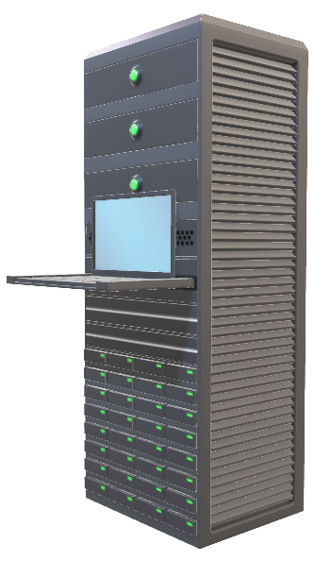
Client-Server Architecture
Host Name | IP Address
Amazon.com | 16.17.100.200
Amazon.com | 16.17.100.201
DNS Server
www.amazon.com
16.17.100.200
Client
16.17.100.200
Server
1.2.3.4
Response
IP-Address
16.17.100.200
Server IP Address

Slide 6
Visual Representation Of DNS
User: Types "amazon.com" into browser.
Resolver: Checks local cache → (if not found) queries DNS server.
DNS Server:
Queries Root Server → gets TLD server for ".com".
Queries TLD Server → gets authoritative server for "amazon.com".
Queries Authoritative Server → gets IP address for "amazon.com".
Resolver: Caches IP address, sends to browser.
Browser: Connects to Amazon web server, loads website.

Slide 7




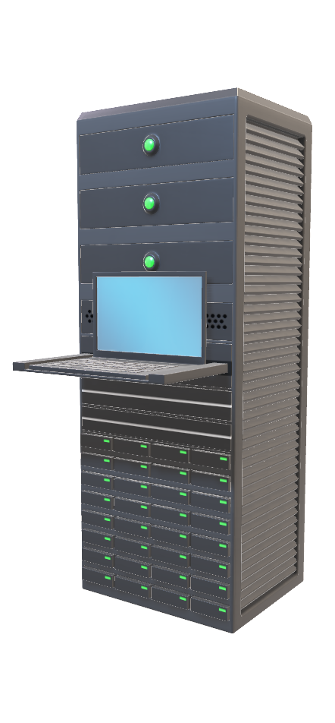
Too much incoming Traffic
www.amazon.com
Increased RAM
request
Increased HDD/SDD
Increased CPU
response
Client
Server
1) Vertical Scaling

Slide 8

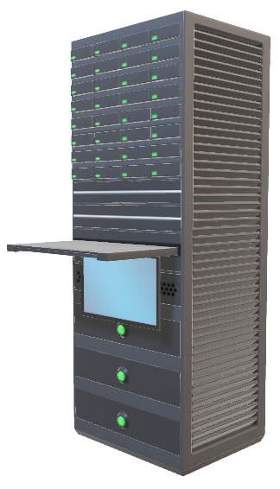
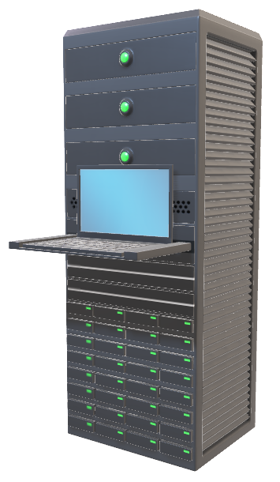





Too much incoming Traffic
www.amazon.com
request
response
Server
Client
2) Horizontal Scaling

Slide 9




Too much incoming Traffic
Data Redundancy
LOAD BALANCER
Server
Client
3) LOAD BALANCER

Slide 10
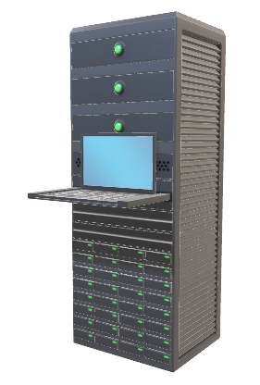

Too much incoming Traffic
LOAD BALANCER
Server
Client
Fault Tolerant

Slide 11
CACHE

Slide 12



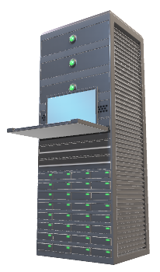


CDN Server
CDN Server
COPY Images, Media File, HTML, CSS, JavaScript in CDN
App Server
CDN Server
CDN

Slide 13


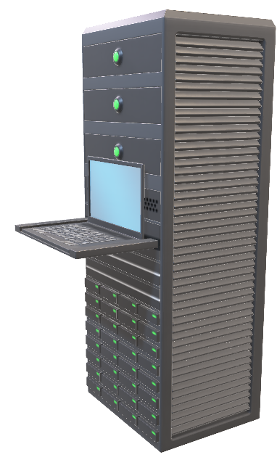
Cache
HDD
RAM
L3 CPU
L2 CPU
L1 CPU

Slide 14
Cache Type | Speed | Location | Size | Latency | Use Case
L1 Cache | Fastest | Closest to the CPU core | 32KB to 128KB | 1-2 CPU cycles | Immediate access to critical CPU instructions/data
L2 Cache | Very Fast | Slightly further from CPU core | 256KB to 8MB | 3-10 CPU cycles | Faster access to frequently used data/instructions
L3 Cache | Fast | Shared among multiple CPU cores | 2MB to 50MB | 10-20 CPU cycles | Shared data among CPU cores to improve performance
RAM | Moderate | Separate from CPU, memory bus | 4GB to 64GB+ | 50-100 nanoseconds | Main memory for active processes and data
HDD/SSD | Slowest | Connected via SATA/interface | 500GB to 10TB+ | Milliseconds | Bulk storage for long-term data and less critical data

Slide 15
Network Protocol

Slide 16
Network Protocols
https://www.amazon.com
Application Layer | | HTTP (Hypertext Transfer | | Protocol)
Transport Layer | | TCP (Transmission Control | | Protocol)
Network Layer | | IP (Internet Protocol)
Data Link Layer | | Ethernet/Wi-Fi
Physical Layer | | Hardware (Cables, Switches)
Software
Hardware

Slide 17
OSI (Open Systems Interconnection) model
7. Application Layer
Add HTTP Header -----------HTTP, FTP, SMTP, DNS, Telnet
6. Presentation Layer
Translation. -------------------------------- JPEG,GIF,PNG
encrypt/Decrypt ----------------------- SSL/TLS
Compress ----------------------------------- ASCII, EBCDIC
5. Session Layer
Manages sessions ------------NetBIOS, RPC
4. Transport Layer
Segmentation -----------------TCP,UDP
Flow control ---------------------SPX
Error detection -----------------RTP
3. Network Layer
Logical addressing --------IP, ICMP, IPsec
Path determination--------Routers, switches
Packet forwarding -------- OSPF, BGP
2. Data Link Layer
- Physical addressing---
Ethernet, PPP, FDDI
Error detection and handling
- Switches, Bridges
Transmits raw bit streams over a physical medium.
Ethernet cables, Fiber optics
1. Physical Layer

Slide 18





Browser send
App Layer
Presentation Layer
Session Layer
http Header
header
header
Translated/compressed
Session created
FRAME
PACKETS
SEGMENTS
Source Mac address
Source IP
Source IP
Source IP
target IP
target IP
target IP
Target Mac address
Network Layer
DataLink Layer
Transport Layer
001110
Reciever
Physical Layer

Slide 19
API – Application programming interface

Slide 20
Types of API
1. Web APIs
2. Library APIs
3. Operating System APIs
4. Database APIs
5. Hardware APIs

Slide 21



SOAP
REST API
GraphQL
API
WEB SOCKET

Slide 22
How REST API Works:
Resources: REST treats everything (like users, posts, or orders) as a resource.
HTTP Methods: RESTful APIs use standard HTTP methods to perform operations on resources:
GET: Retrieve a resource.
POST: Create a new resource.
PUT: Update an existing resource.
DELETE: Remove a resource.
PATCH: Apply partial modifications to a resource.
URIs (Uniform Resource Identifiers): Each resource is accessible via a unique URI. For example, /users might refer to a collection of users, while /users/123 refers to a specific user.

Slide 23
API Pattern | Description | Use Cases | Examples
REST (Representational State Transfer) | Architectural style that uses standard HTTP methods (GET, POST, PUT, DELETE) and stateless communication. | CRUD operations, web services, mobile apps | Google Maps API, Twitter API
SOAP (Simple Object Access Protocol) | Protocol that uses XML for message format and relies on HTTP, SMTP, or other protocols for message negotiation and transmission. | Enterprise services, banking, financial applications | PayPal API, Salesforce API
GraphQL | Query language for APIs that allows clients to request only the data they need, and nothing more. | Real-time data updates, mobile apps, complex data | GitHub API, Facebook API
gRPC (gRPC Remote Procedure Calls) | Open-source RPC framework that uses HTTP/2 for transport, Protocol Buffers as the interface description language. | Low-latency communication, microservices | Google Cloud APIs, Netflix API
WebSockets | Communication protocol providing full-duplex communication channels over a single TCP connection. | Real-time data transfer, chat applications, gaming | Slack API, Stock Market APIs

Slide 24
DATABASES
Relational Databases (RDBMS)
NoSQL Databases
Examples:MongoDB
CouchDB
Redis
Riak
Amazon DynamoDB
Apache Cassandra
Google Spanner
CockroachDB
Examples:MySQL
PostgreSQL
Oracle Database
Microsoft SQL Server

Slide 25
Database Type | Description | Use Cases | When to Choose | Examples
Relational (SQL) | Uses structured query language (SQL) and predefined schemas for data storage and retrieval. | Transactional systems, CRM, ERP, finance | When data integrity, ACID compliance, and complex queries are required. | MySQL, PostgreSQL, Oracle, Microsoft SQL Server
Document (NoSQL) | Stores data as documents, typically in JSON or BSON format. | Content management, e-commerce, user profiles | When working with semi-structured data and requiring flexibility in data models. | MongoDB, Couchbase, Firebase Firestore
Key-Value (NoSQL) | Stores data as key-value pairs. | Caching, session management, configuration storage | When needing fast read/write operations and handling large volumes of simple queries. | Redis, DynamoDB, Riak
Graph (NoSQL) | Uses graph structures with nodes, edges, and properties to represent and store data. | Social networks, fraud detection, recommendation engines | When relationships between data points are complex and querying relationships is essential. | Neo4j, Amazon Neptune, ArangoDB
Time-Series | Optimized for time-stamped or time-series data storage and retrieval. | Monitoring, IoT, financial data | When handling time-stamped data and requiring efficient time-based queries and analysis. | InfluxDB, TimescaleDB, OpenTSDB
Object-Oriented | Stores data in the form of objects, similar to object-oriented programming. | Complex data representations, multimedia applications | When integrating with object-oriented programming languages and requiring complex data models. | db4o, ObjectDB, InterSystems Caché
In-Memory | Stores data primarily in memory for fast access. | Real-time applications, gaming, caching | When requiring extremely fast read/write operations and handling transient data. | Redis, Memcached, Hazelcast
Multi-Model | Supports multiple data models (e.g., document, graph, key-value) within a single database engine. | Versatile applications, hybrid use cases | When needing flexibility to store different types of data and requiring various querying capabilities. | ArangoDB, MarkLogic, OrientDB

Slide 26
ACID VRS BASE

Slide 27
ACID Property | Description | Importance | Example
Atomicity | Ensures that all operations within a transaction are completed successfully; if any operation fails, the entire transaction fails, and the database state remains unchanged. | Guarantees that partial updates are not made to the database, ensuring data integrity. | In a banking application, transferring money from one account to another should either complete entirely or not at all.
Consistency | Ensures that a transaction brings the database from one valid state to another valid state, maintaining all predefined rules, such as constraints, cascades, and triggers. | Ensures that the database adheres to its defined rules, preserving the correctness and validity of the data. | When inserting data, all mandatory fields must be filled, and all foreign keys must point to existing records.
Isolation | Ensures that the operations of a transaction are isolated from those of other transactions, preventing concurrent transactions from interfering with each other. | Guarantees that transactions do not affect each other’s execution, preventing data corruption or inconsistencies. | Two customers updating their bank balances simultaneously will not see each other's uncommitted changes.
Durability | Ensures that once a transaction is committed, its changes are permanent, even in the event of a system failure. | Guarantees that committed transactions are saved and can be recovered after a crash, ensuring data persistence. | After a power outage, completed transactions will still be reflected in the database once the system is back up.

Slide 28
BASE Model:
Basically Available: The system guarantees availability, even in the event of partial system failures.
Soft state: The state of the system may change over time, even without input (due to eventual consistency).
Eventual consistency: The system will become consistent over time, given that there are no further updates.

Slide 29
Optimization Technique | Description | Use Cases | Examples
Indexing | Creating indexes on columns to speed up data retrieval. | Frequently queried columns, large datasets | B-tree indexes, Hash indexes, Full-text indexes
Query Optimization | Writing efficient SQL queries and using query optimization tools to improve performance. | Complex queries, high-traffic databases | Using EXPLAIN, avoiding SELECT *, proper JOIN usage
Normalization | Organizing data to reduce redundancy and improve data integrity. | Reducing data anomalies, ensuring data consistency | Normal forms (1NF, 2NF, 3NF), decomposing tables
Denormalization | Introducing redundancy to improve read performance. | Read-heavy workloads, data warehousing | Creating summary tables, adding redundant columns
Sharding | Splitting a database into smaller, more manageable pieces called shards. | Large-scale databases, distributed systems | Horizontal partitioning, geo-based sharding
Caching | Storing frequently accessed data in a fast storage layer. | High-read operations, reducing database load | Redis, Memcached, application-level caching
Materialized Views | Storing the result of a query for fast access. | Complex queries, improving read performance | Precomputed joins and aggregates
Partitioning | Dividing a database into smaller, more manageable segments. | Large tables, improving query performance | Range partitioning, list partitioning, hash partitioning
Connection Pooling | Reusing database connections to reduce overhead. | High-concurrency environments, web applications | HikariCP, c3p0, database connection pooling libraries
Database Compression | Reducing the size of the data stored in the database. | Large datasets, reducing storage costs | Columnar compression, row-level compression
Load Balancing | Distributing database requests across multiple servers. | High-availability systems, distributed databases | Master-slave replication, round-robin load balancing
Database Monitoring | Continuously monitoring database performance and usage. | Proactive performance management, identifying bottlenecks | Monitoring tools like Prometheus, Grafana, New Relic, database logs
Read Replicas | Using replicas of the primary database to handle read queries. | Read-heavy workloads, improving read performance | MySQL replication, PostgreSQL streaming replication, Amazon RDS Read Replicas
Query Caching | Caching the results of expensive queries to avoid rerunning them. | Frequently run complex queries, reducing database load | MySQL query cache, application-level query caching

Slide 30
LATENCY vrs. THROUGHPUT

Slide 31
Latency vs. Throughput: Key Differences
Aspect | Latency | Throughput
Definition | The time it takes for a data packet to travel from source to destination. | The amount of data transmitted successfully over a network in a given amount of time.
Measurement | Measured in time units (milliseconds, seconds). | Measured in data units per time (bits per second, Mbps, Gbps).
Focus | Time taken for individual requests. | Volume of data processed over time.
Significance | Important for real-time applications (e.g., gaming, video conferencing). | Important for bulk data transfer (e.g., file downloads, data backups).
Impact | High latency can cause delays and lag. | High throughput allows more data to be transferred in less time.
Optimization | Reduced by improving routing, faster networks, closer data centers. | Improved by increasing bandwidth, optimizing data paths, using efficient protocols.
Relation | Low latency often enhances user experience. | High throughput increases overall system performance.
Examples | Ping time, round-trip time in network communications. | Data transfer rate, network bandwidth utilization.
Dependency | Dependent on the speed of the network and distance between points. | Dependent on the network capacity and efficiency of data handling.

Slide 32
Unit | Actual Value in Bytes | Roundoff Value in Bytes | Equivalent in Large Numbers | Power of 10
1 Byte | 1 Byte | 1 Byte or 8bits | 1 (one) | 10^0
1 KB | 1,024 Bytes | 1,000 Bytes | 1,000 (1 thousand) | 10^3
1 MB | 1,024 KB | 1,000,000 Bytes | 1,000,000 (1 million) | 10^6
1 GB | 1,024 MB | 1,000,000,000 Bytes | 1,000,000,000 (1 billion) | 10^9
1 TB | 1,024 GB | 1,000,000,000,000 Bytes | 1,000,000,000,000 (1 trillion) | 10^12
1 PB | 1,024 TB | 1,000,000,000,000,000 Bytes | 1,000,000,000,000,000 (1 quadrillion) | 10^15

Slide 33
Scenario: You are downloading a 500 MB file from the internet,
and it takes 200 seconds to complete the download.
Throughput=Total Data/Total Time​
Given:
Total Data = 500 MB
Total Time = 200 seconds
Throughput=500MB/ 200 sec
Throughput=2.5MBps

Slide 34
Example 2: Calculating Network Latency
Scenario: You ping a server, and the round-trip time (RTT) for the packet is 50 milliseconds.
Step-by-Step Calculation:
Identify the RTT: The round-trip time for the packet is 50 milliseconds (ms).
Calculate one-way latency (if needed):
Network latency is often considered as the one-way delay.
One-way latency = RTT / 2
One-way latency = 50 ms / 2
One-way latency = 25 ms
Result: The network latency is 25 ms for one-way or 50 ms for the round trip.

Slide 35
CAP Theorem vrs PACLC Theory

Slide 36
Aspect | CAP Theorem | PACLC Theory
Focus | Balances Consistency, Availability, and Partition Tolerance. | Balances Performance, Availability, Consistency, Latency, and Complexity.
Trade-offs | Must sacrifice one of Consistency, Availability, or Partition Tolerance in a distributed system. | Aims to balance all five aspects but recognizes that trade-offs will be necessary based on requirements.
Use Cases | Distributed databases, systems with network partitions, systems requiring high availability or consistency. | Real-time systems, applications requiring low latency, systems where performance and complexity are critical.
Examples | - CP systems prioritize Consistency and Partition Tolerance <br> - AP systems prioritize Availability and Partition Tolerance | - High performance, low complexity systems like Redis <br> - High consistency, low latency systems like financial systems

Slide 37
CAP Theorem
Aspect | Description | Use Cases
Consistency | Ensures that all nodes see the same data at the same time. Any read operation will return the most recent write. | Financial transactions, banking systems, applications requiring up-to-date information
Availability | Ensures that every request receives a response, without guaranteeing that it contains the most recent write. | E-commerce websites, online gaming platforms, systems requiring high availability
Partition Tolerance | Ensures that the system continues to operate despite arbitrary partitioning due to network failures. | Distributed systems, microservices architectures, applications running on unreliable networks
Description | The CAP theorem states that in a distributed data store, you can only achieve two out of the three guarantees: Consistency, Availability, and Partition Tolerance.
Examples | - CP: Consistency and Partition Tolerance (e.g., HBase, MongoDB in default configuration) <br> - AP: Availability and Partition Tolerance (e.g., CouchDB, DynamoDB) <br> - CA: Consistency and Availability (impossible to achieve in distributed systems)

Slide 38
PACLC Theory
Aspect | Description | Use Cases
Performance | Ensures that the system performs efficiently under normal and peak loads. | Real-time analytics, high-frequency trading, applications requiring low latency
Availability | Ensures that the system is available to serve requests without downtime. | E-commerce websites, online services, systems requiring high uptime
Consistency | Ensures that data remains consistent across the system, especially in distributed environments. | Financial systems, inventory management, applications requiring accurate data
Latency | Ensures low response times for read and write operations. | Real-time systems, gaming platforms, applications requiring quick response times
Complexity | Refers to the complexity of implementing and maintaining the system, including considerations of architecture, scalability, and fault tolerance. | Large-scale distributed systems, microservices architectures, applications requiring complex coordination
Description | The PACLC theory addresses five dimensions: Performance, Availability, Consistency, Latency, and Complexity, aiming to balance these aspects in system design.
Examples | - High Performance, Low Complexity: In-memory databases like Redis <br> - High Consistency, Low Latency: Financial transaction systems <br> - High Availability, Manageable Complexity: Cloud-based services like AWS or Azure

Slide 39
Messaging Queue

Slide 40
Messaging Queue
Aspect | Description | Use Cases | Examples
Messaging Queue | A messaging queue is a form of asynchronous service-to-service communication used in serverless and microservices architectures. Messages are stored in a queue & processed by consumers independently. | Decoupling components, ensuring reliable communication, handling asynchronous tasks. | RabbitMQ, Apache Kafka, Amazon SQS, Microsoft Azure Queue Storage

Slide 41
Frontend Web Architecture
Architecture Type | Use Cases | Key Technologies
Single-Page Application (SPA) | Highly interactive applications, dashboards, real-time data applications, social media platforms | React, Angular, Vue.js, Svelte
Multi-Page Application (MPA) | Content-heavy websites like blogs, news sites, e-commerce platforms | Traditional HTML, CSS, JavaScript, jQuery, server-side technologies (e.g., PHP, Ruby on Rails)
Progressive Web Application (PWA) | Applications needing offline functionality, enhanced performance, or a native app-like experience | Service Workers, Web App Manifests, React, Angular, Vue.js
Microfrontends | Large-scale applications needing independent deployability and scalability for different parts of the frontend | Web Components, Module Federation, Single-SPA, custom elements, iframes

Slide 42
Back-End Architectures

Slide 43
Backend Architectures
Architecture Type | Description | Use Cases
Monolithic Architecture | The entire application is built as a single unit, often with a single codebase and deployment artifact. It's simple to develop but can become complex and hard to maintain as the application grows. | Small to medium-sized web applications, prototyping projects, applications where the entire functionality can be easily managed within a single codebase.
Microservices Architecture | The application is divided into smaller, independent services, each responsible for a specific function. It offers scalability, flexibility, and resilience but adds complexity in terms of deployment and management. | Large-scale applications with complex requirements, applications that need to scale rapidly, systems that require high availability and fault tolerance.
Serverless Architecture | Also known as Function as a Service (FaaS), this architecture allows developers to deploy individual functions or pieces of code without managing servers. It's scalable, cost-effective, and efficient for certain types of applications. | Event-driven applications, applications with unpredictable traffic patterns, applications with short-lived and asynchronous tasks.
Service-Oriented Architecture (SOA) | Applications are built as a collection of loosely coupled services that communicate with each other over a network. It promotes reusability and flexibility but can be complex to implement. | Enterprise applications with distributed components, systems that require interoperability between different services, applications that need to integrate with external systems or services.
Event-Driven Architecture (EDA) | Components within the system communicate with each other by triggering events. It's useful for handling asynchronous operations and can improve scalability and responsiveness. | Real-time applications, systems that require handling of asynchronous events, applications with complex workflows or business processes.

Slide 44
CLOUD Services

Slide 45
Category | AWS | Azure | Google Cloud | Use Cases
Compute | EC2 (Elastic Compute Cloud), Lambda | Virtual Machines, Azure Functions | Compute Engine, Cloud Functions | Hosting applications, running batch processing jobs, serverless computing
Storage | S3 (Simple Storage Service), EBS | Blob Storage, File Storage, Disk Storage | Cloud Storage, Persistent Disk | Storing files, backups, serving static content, database storage
Database | RDS (Relational Database Service), DynamoDB | SQL Database, Cosmos DB | Cloud SQL, Cloud Spanner, Bigtable | Relational databases, NoSQL databases, scalable and high-performance databases
Networking | VPC (Virtual Private Cloud), Route 53 | Virtual Network, Azure DNS | Virtual Private Cloud (VPC), Cloud DNS | Setting up private networks, DNS management, load balancing
Security | IAM (Identity and Access Management) | Azure Active Directory | Cloud Identity-Aware Proxy | Access control, identity management, encryption
Monitoring | CloudWatch | Azure Monitor | Stackdriver Monitoring | Monitoring resource usage, logging, and alerts
Analytics | Amazon Redshift, Kinesis | Azure Synapse Analytics, HDInsight | BigQuery, Dataflow, Dataproc | Big data analytics, real-time data processing, data warehousing
AI/ML | Amazon SageMaker, Lex, Polly | Azure Machine Learning, Cognitive Services | AI Platform, AutoML, TensorFlow | Machine learning models, natural language processing, computer vision
Serverless | AWS Lambda | Azure Functions | Cloud Functions | Event-driven computing, running code without provisioning or managing servers
Containers | Amazon ECS, EKS | Azure Kubernetes Service (AKS) | Google Kubernetes Engine (GKE) | Container orchestration, managing Docker containers
DevOps | CodePipeline, CodeDeploy, CodeCommit | Azure DevOps, Azure Pipelines | Cloud Build, Cloud Deployment Manager | Continuous integration and deployment, version control, automated testing
Mobile | AWS Amplify | Azure Mobile Apps | Firebase | Building and managing mobile apps, backend services for mobile apps
IoT | AWS IoT Core | Azure IoT Hub | Cloud IoT Core | Connecting and managing IoT devices, processing and analyzing IoT data
Blockchain | Amazon Managed Blockchain | Azure Blockchain Service | Google Cloud Blockchain | Implementing blockchain solutions, creating and managing blockchain networks

Slide 46
Security | Authentication | Verifying user identity (e.g., OAuth, JWT). | Ensuring only authorized users access the system.
 | Authorization | Ensuring users have permission to perform actions. | Enforcing user permissions and access control.
 | Encryption | Protecting data in transit (TLS/SSL) and at rest. | Securing sensitive data from unauthorized access.
 | Firewalls | Protecting networks from unauthorized access. | Controlling incoming and outgoing network traffic.
 | Intrusion Detection Systems (IDS) | Monitoring for malicious activity. | Detecting and responding to security threats.
 | Web Application Firewalls (WAF) | Protecting web applications from attacks. | Shielding web applications from common threats like SQL injection.
 | DDoS Protection | Mitigating Distributed Denial of Service attacks. | Protecting services from being overwhelmed by malicious traffic.

Slide 47
How to System Design: E-commerce like Amazon.com,Flipkart etc..
1) Functional Requirement
2) NON- Functional Requirement
3) Capacity Estimation
4) DB Design
5) API Design
6) HLD
7) SPOF
8) Scale for Millions, Billions Users

Slide 48
Data Size Conversions
Unit | Abbreviation | Bytes (10^x) | Equivalent Bytes | Numerical Value
Kilobyte | KB | 10^3 | 1,000 bytes | 1 Thousand
Megabyte | MB | 10^6 | 1,000,000 bytes | 1 Million
Gigabyte | GB | 10^9 | 1,000,000,000 bytes | 1 Billion
Terabyte | TB | 10^12 | 1,000,000,000,000 bytes | 1 Trillion
Petabyte | PB | 10^15 | 1,000,000,000,000,000 bytes | 1 Quadrillion

